Slide 1

Capital Budgeting : Part I
Investment Criteria

Slide 2
Investment Criteria
How should a firm make an investment decision
  What assets do we buy?
  What is the underlying goal?
  What is the right decision criterion?
Capital Budgeting
Evaluate different decision rules → tools!
Implement using the Super Project case study
Notes:
Roles of managers:
Identify and invest in products and business acquisitions that will maximize the current market value of equity.
Learn to identify which products will succeed and which will fail.
Managers need objective criteria to evaluate decisions

Slide 3
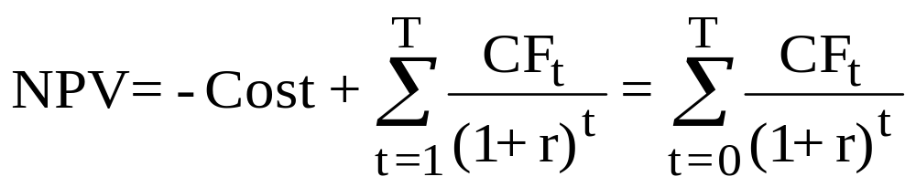
Net Present Value
NPV = –Initial Cost + Market Value
NPV = – Initial Cost + PV(Expected Future CF’s)
where r reflects the risk of the project’s cash flows
Note that this is a generic formula, and we really use the tools from time value of money (annuities, perpetuities, etc.) from before.
Net Present Value (NPV) Rule:
  NPV > 0 Accept the project.
  NPV < 0 Reject the project.
Notes:
Investment is worth undertaking if it creates value for its owners, I.e. it is worth more than it costs.
Finding the market value of the investment
Use discounted cash flow valuation (calculate present values).
Compute the present values of future cash flows
Net Present Value Rule (NPV): An investment should be accepted if the net present value is positive and rejected if the net present value is negative.
Positive NPV projects create shareholder value.
NPV Rule is the best decision rule because it leads to decisions that max. current value of investors’ claims on the firm’s cash flows and investor welfare.

Slide 4
More on the Appropriate
Discount Rate, r
Discount rate = opportunity cost of capital
  Expected rate of return given up by investing in the project
  Reflects the risk of the cash flows from the project
Discount rate does not reflect the risk of the firm or the risk of the firm’s previous projects (remember: the past is irrelevant)

Slide 5
Using the NPV Rule
Your firm is considering whether to invest in a new product. The costs associated with introducing this new product and the expected cash flows over the next four years are listed below. (Assume these cash flows are 100% likely). The appropriate discount rate for these cash flows is 20% per year. Should the firm invest in this new product?
Costs: ($ million)
Promotion and advertising 100
Production & related costs 400
Other 100
Total Cost 600
Initial Cost: $600 million and r = 20%
The cash flows ($million) over the next four years:
Year 1: $200; Year 2: $220; Year 3: $225; Year 4: $210
Should the firm proceed with the project?

Slide 6
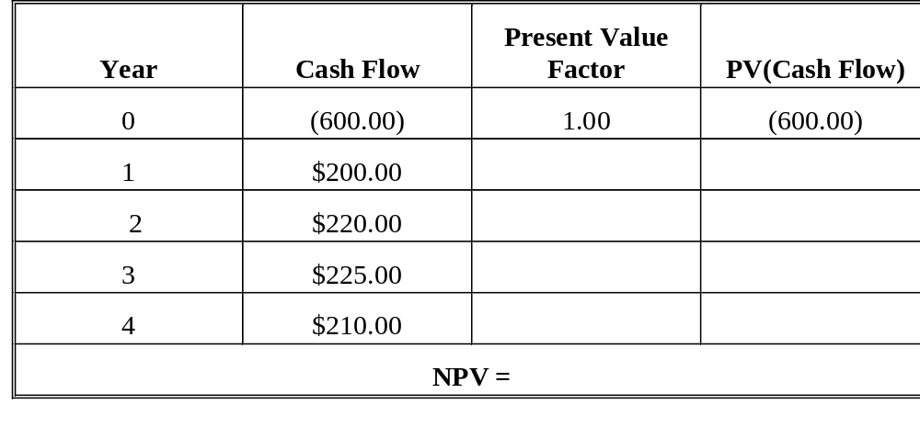
Using NPV, concluded
(1.20)¹ 166.67
(1.20)² 152.78
(1.20)³ 130.21
(1.20)⁴ 101.27
(49.07)
Notes:
Two comments:
1) Process of discounting is not that important. Coming up with the appropriate discount rate and cash flows is the key.
2) NPV is an estimate.

Slide 7
Payback Rule
Payback period = the length of time until the accumulated cash flows from the investment are equal to or exceed the original cost
Payback rule: If the calculated payback period is less than or equal to some pre-specified payback period, then accept the project. Otherwise reject it.
Notes:
Payback - time it takes to recover initial investment

Slide 8
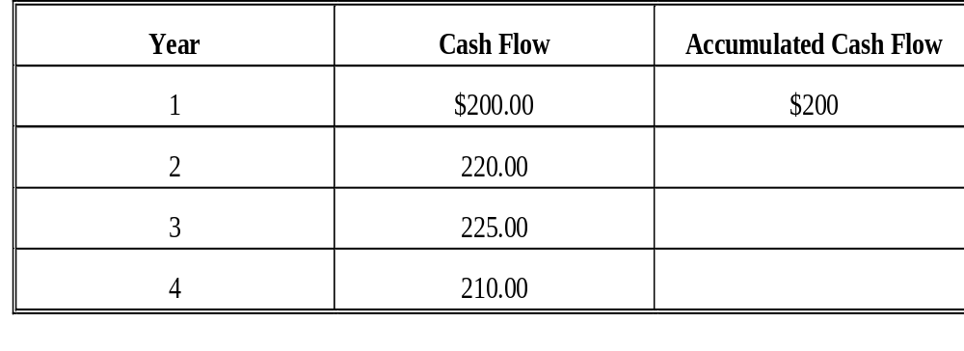
Example: Payback
Example: Consider the previous investment project. The initial cost is $600 million. It has been decided that the project should be accepted if the payback period is 3 years or less. Using the payback rule, should this project be undertaken?
$420
$645 > $600
$855
Notes:
Payback = 2 years + 180/225 = 2.8 years = 2 years 10 months
Example: Calculating the payback period: The projected cash flows from a proposed investment are listed below. The initial cost is $500. What is the payback period for this investment?
Payback = 2 years + 200/500 = 2.4 years = 2 years 5 months

Slide 9
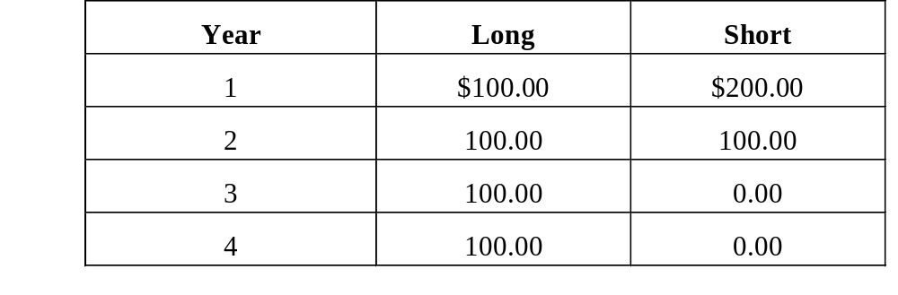
Analyzing the Payback Rule
Consider the following table. The payback period cutoff is two years. Both projects cost $250. Which would you pick using the payback rule? Why?
Which project would you pick using the NPV rule? Assume the appropriate discount rate is 20%.
Notes:
Payback (Long) = 2.5 years
Payback (short) = 1.5 years
NPV(Long ) = $8.87
NPV(short) = -13.89

Slide 10
Advantages and Disadvantages of the Payback Rule
Advantages
Disadvantages
Popular among many large companies
  Commonly used when the:
    capital investment is small
    merits of the project are so obvious that more formal analysis is unnecessary
Notes:
Advantages and Disadvantages of the Payback Rule
Advantages
Easy to Understand
Biased toward liquidity
Allows for quick evaluation of managers
Adjusts for uncertainty of later cash flows (by ignoring them altogether)
Disadvantages
Ignores the time value of money
Ignores cash flow beyond the payback period
Biased against long-term projects
Subjective decision rule

Slide 11
The Discounted Payback Rule
Discounted Payback period: The length of time until the accumulated discounted cash flows from the investment equal or exceed the original cost. (We will assume that cash flows are generated continuously during a period)
The Discounted Payback Rule: An investment is accepted if its calculated discounted payback period is less than or equal to some pre-specified number of years.

Slide 12
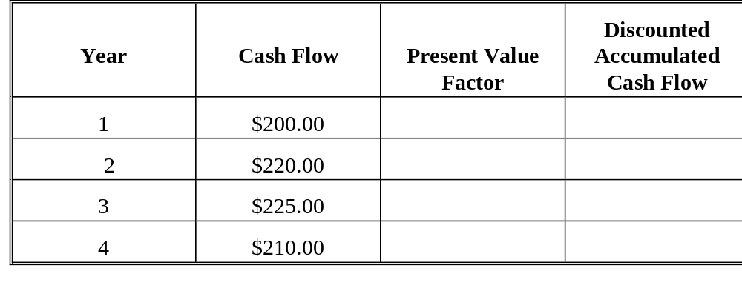
Example: Discounted Payback
Example: Consider the previous investment project analyzed with the NPV rule. The initial cost is $600 million. The discounted payback period cutoff is 3 years. The appropriate discount rate for these cash flows is 20%. Using the discounted payback rule, should the firm invest in the new product?
(1.20)¹ 166.67
(1.20)² 152.78 319.45
(1.20)³ 130.21 449.66
(1.20)⁴ 101.27 550.93

Slide 13
Analyzing the Discounted Payback Rule
Advantages
Disadvantages
Bottom Line:
Why Bother? You might as well compute the NPV! Will always work!
Notes:
Involves discounting as in the NPV rule
It does not consider the risk differences between investments. Yet, we can discount with a higher interest rate for a riskier project.
How do you come up with the right discounted payback period cut-off? Arbitrary number.
Advantages
If a project ever pays back on a discounted basis, then it must have a positive NPV.
Biased toward liquidity
Easy to understand
Disadvantages
May reject positive NPV projects
Arbitrary discounted payback period
Biased against long-term projects

Slide 14
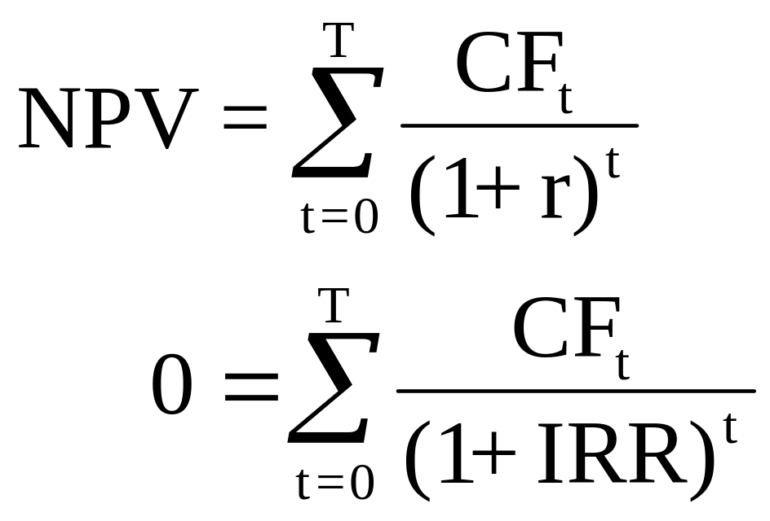
Internal Rate of Return (IRR) Rule
IRR is that discount rate, r, that makes the NPV equal to zero. In other words, it makes the present value of future cash flows equal to the initial cost of the investment.

Slide 15
IRR Rule
Accept the project if the IRR is greater than the required rate of return (discount rate). Otherwise, reject the project.
Calculating IRR: Like Yield-to-Maturity, IRR is difficult to calculate.
  Need financial calculator
  Trial and error
  Excel or Lotus Spreadsheet
  Easy to first calculate NPV then use the answer to get a first good guess about the IRR!!!

Slide 16
IRR Illustrated
Initial outlay = -$200
Year Cash flow
1 50
2 100
3 150
Find the IRR such that NPV = 0
50 100 150
0 = -200 + + +
(1+IRR)¹ (1+IRR)² (1+IRR)³
50 100 150
200 = + +
(1+IRR)¹ (1+IRR)² (1+IRR)³

Slide 17
IRR Illustrated
Trial and Error
Discount rates NPV
0% $100
5% 68
10% 41
15% 18
20% –2
IRR is just under 20% -- about 19.44%

Slide 18
Net Present Value Profile
Net present value
120
Year Cash flow
0 – $200
1 50
2 100
3 150
4 0
100
80
60
40
20
0
– 20
– 40
Discount rate
2%
6%
10%
14%
18%
22%
IRR

Slide 19
Comparison of IRR and NPV
IRR and NPV rules lead to identical decisions IF the following conditions are satisfied:
  Conventional Cash Flows: The first cash flow (the initial investment) is negative and all the remaining cash flows are positive
  Project is independent: A project is independent if the decision to accept or reject the project does not affect the decision to accept or reject any other project.
When one or both of these conditions are not met, problems with using the IRR rule can result!

Slide 20
Unconventional Cash Flows
Unconventional Cash Flows: Cash flows come first and investment cost is paid later. In this case, the cash flows are like those of a loan and the IRR is like a borrowing rate. Thus, in this case a lower IRR is better than a higher IRR.
Multiple rates of return problem: Multiple sign changes in the cash flows introduce the possibility that more than one discount rate makes the NPV of an investment project zero.

Slide 21
Example: Unconventional Cash Flows
Example: A strip-mining project requires an initial investment of $60. The cash flow in the first year is $155. In the second year, the mine is depleted, but the firm has to spend $100 to restore the land.
$60 = 155/(1 + IRR) – 100/(1 + IRR)²
Discount Rate (IRR) NPV
0.0% – $5.00
10.00 – 1.74
20.00 – 0.28
25.00 0.00
30.00 0.06
33.33 0.00
40.00 – 0.31
Generally, the number of possible IRRs is equal to the number of changes in the sign of the cash flows.

Slide 22
Mutually Exclusive Projects
Mutually exclusive projects: If taking one project implies another project is not taken, the projects are mutually exclusive. The one with the highest IRR may not be the one with the highest NPV.
Example: Project A has a cost of $500 and cash flows of $325 for two periods, while project B has a cost of $400 and cash flows of $325 and $200 respectively, in years 1 and 2.
Notes:
Example: If you own an empty lot in Oakland, you can either build an apartment building or a bar, but not both.

Slide 23
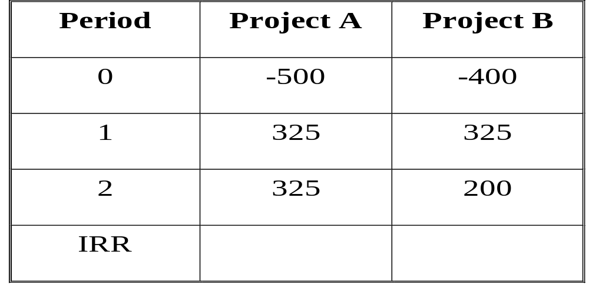
Mutually Exclusive Projects
19.43%
22.17%
Project B appears better because of the higher return. However...

Slide 24
Mutually Exclusive Projects
Discount Rate NPV(A) NPV(B)
0.0% $150.00 $125.00
5.00 104.32 100.00
10.00 64.05 60.74
15.00 28.36 33.84
20.00 -3.47 9.72
Which project is preferred depends on the discount rate.
Project A has a higher NPV at a 10% discount rate
Project B has a higher NPV at a 15% discount rate.

Slide 25
Crossover Rate
Crossover Rate: The discount rate that makes the NPV of the two projects the same.
Finding the Crossover Rate
  Use the NPV profiles
  Calculate the IRR based on the incremental cash flows.
  If the incremental IRR is greater than the required rate of return, take the larger project.

Slide 26
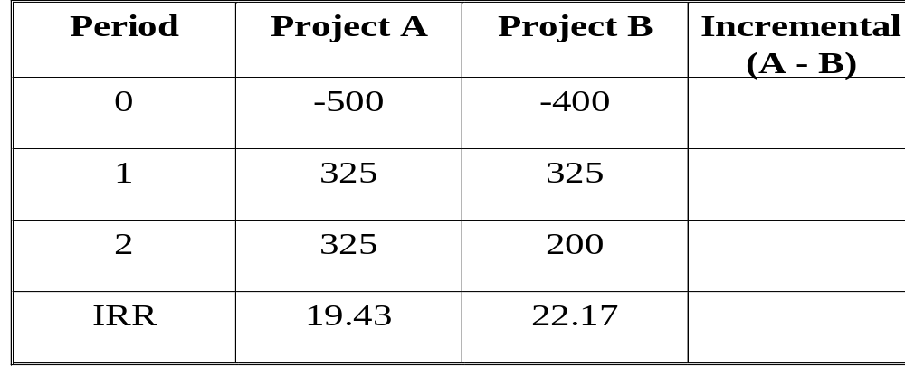
Mutually Exclusive Cash Flows
Example: If project A has a cost of $500 and cash flows of $325 for two periods, while project B has a cost of $400 and cash flows of $325 and $200 respectively, the incremental cash flows are:
–$100
0
125
100=125/(1+IRR)² → IRR=11.8%

Slide 27
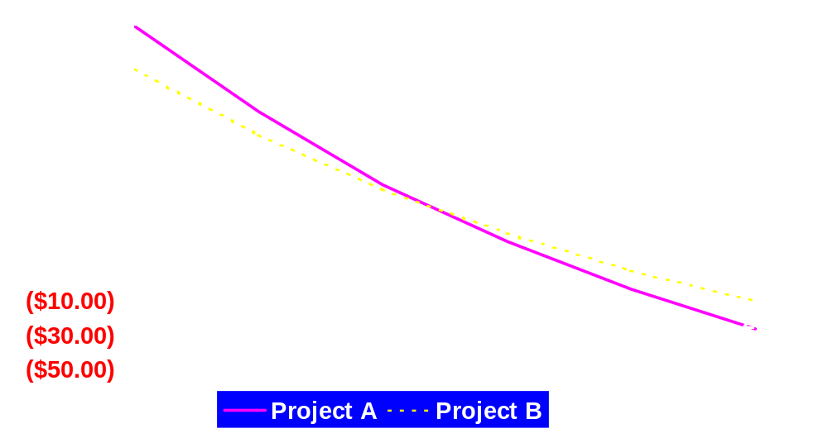
NPV Profiles of Mutually
Exclusive Projects
Crossover Rate = 11.8
IRR_{B}=22.17
IRR_{A}=19.43

Slide 28
Advantages and Disadvantages of IRR
Advantages
  closely related to NPV
  easy to understand and communicate
Disadvantages
  may result in multiple answers
  may lead to incorrect decisions
  not always easy to calculate
Very Popular: People like to talk in terms of returns
  99% use IRR Rule instead of 85% using NPV rule

Slide 29
Capital Budgeting:
Determining the Relevant Cash Flows
Relevant cash flows - the incremental cash flows associated with the decision to invest in a project.
The incremental cash flows for project evaluation consist of any and all changes in the firm’s future cash flows that are a direct consequence of taking the project.
Difference between cash flows with project and cash flows without

Slide 30
Stand-Alone Principle
Evaluation of a project on the basis of its incremental cash flows
Project = "Mini-firm”
  has own assets and liabilities; revenues and costs
Allows us to evaluate the investment project separately from other activities of the firm

Slide 31
Aspects of Incremental
Cash Flows
Sunk Costs
Opportunity Costs
Side Effects: Erosion
Net Working Capital
Financing Costs
All Cash Flows should be after-tax cash flows
Notes:
sunk costs - a cost that has already occurred
(1)should be ignored
(2)example: test market expenses
opportunity cost - cost of the best foregone alternative
highest return that could be earned if project is not taken - what is firm giving up?
(1)Example: education; opportunity cost is lost wages
side effects
(1)erosion - cash flow transferred to new project from customers and sales of other products of the firm (cannibalization)
(2)Example: Nike shoes, Air Jordans
working capital - difference between current assets and current liabilities
(1) represents cash outflow, since cash generated elsewhere in firm is tied up in project. New product generally requires add’l inventory and leads to increased accts receivable. Increase in payables and accruals will offset some of this, but NWC will increase during life of project
(2) often 100% is recovered at end of project
financing costs - separate investment from financing decision. Only interested I CFs from assets. Will show later that discount rate incorporates any financing costs.

Slide 32
Sunk Costs
Heinz hires The Boston Consulting Group (BCG) to evaluate whether a new product line should be launched. The consulting fees are paid no matter what.
Should not be included in incremental cash flows!
Valuation is always forward looking!

Slide 33
Opportunity Costs
Firm paid $300,000 land to be used for a warehouse. The current market value of the land is $450,000.
Opportunity Cost = $450,000
Sunk Cost = $300,000
Should be included
in incremental cash flows -
but beware of tax consequences!

Slide 34
Side Effects and Erosion
A drop in Big Mac revenues when McDonald's introduced the Arch Deluxe.
Should be included
in incremental cash flows
Notes:
Nike - Michael Jordan and Kevin Garnett
Fila - Grant Hill and Allen Iverson

Slide 35
Net Working Capital
(incremental) Investments in inventories and receivables.
This investment is assumed to be
recovered at the end of project.
Should
be included
in incremental cash flows

Slide 36
Financing Costs
Interest, principal on debt and dividends.
Should not
be included
in incremental cash flows

Slide 37
Aspects of Incremental
Cash Flows
Sunk Costs N
Opportunity Costs Y
Side Effects (Erosion) Y
Net Working Capital Y
Financing Costs N
All Cash Flows should be
after-tax cash flows

Slide 38
Pro Forma Financial Statements
and DCF Valuation
Pro forma financial statements
  Best current forecasts of future years operations
    used for capital budgeting
    determine sales projections, costs, capital requirements
  Use statements to obtain project cash flow
If stand-alone principle holds:
Project Cash Flow = Project Operating Cash Flow
– Project Net Capital Spending
– Project Additions to Net Working Capital
Notes:
OCF = EBIT + depreciation - taxes

Slide 39
Depreciation
Depreciation is a non-cash charge, but has cash flow consequences because it affects the tax bill
To estimate depreciation expense:
  Calculate depreciable basis.
  Ignore economic life and future market value (salvage value).
  Use tax accounting rules for depreciation.
    Modified Accelerated Cost Recovery System (MACRS)
    Straight line
    Half-year convention
Book value versus market value
Notes:
Depreciable basis - cost of asset plus an shipping or installation charges. This is the amount that is depreciated.
Use tax accounting rules for depreciation since we are interested in its effect on taxes.
3 - 10 year property can be depreciated using SL or accelerated methods. Since accelerated depreciation results in lower tax bill and higher CF, most firms use this.
Half-year convention - assumes asset is placed in service during middle of year, and ends in middle of last year. Result is that 3 year assets are depreciated over 4 tax years
Book vs. Market - when assets is sold, pay taxes on difference between market value and book value
CF(salvage) = market value - (market - book)*tax rate

Slide 40
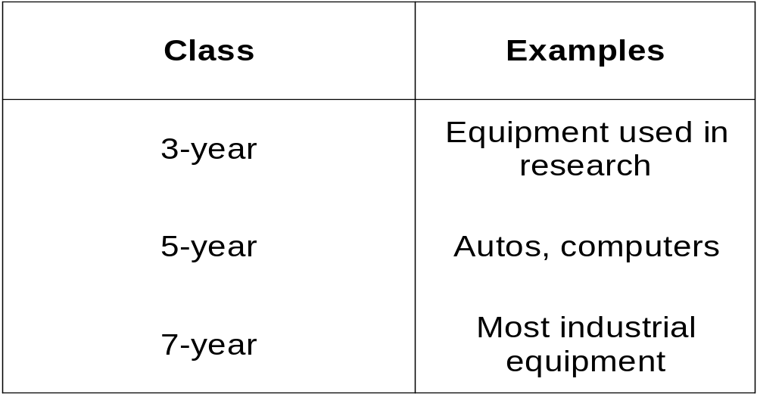
Modified ACRS Property Classes
Notes:
Under MACRS, all assets are assigned to a particular class, which establishes their life for tax purposes

Slide 41
Modified ACRS Depreciation Allowances
Year
3-year
5-year
7-year
1
33.33%
20%
14.29%
2
44.44%
32%
24.49%
3
14.82%
19.2%
17.49%
4
7.41%
11.52%
12.49%
5
11.52%
8.93%
6
5.76%
8.93%
7
8.93%
8
4.45%
Notes:
Based on double-declining balance

Slide 42
Straight Line vs. MACRS Depreciation
The Union Company purchased a new computer for $30,000.
The computer is treated as a 5-year property under MACRS and is expected to have a salvage value of zero in six years.
What are the yearly depreciation deductions using Modified ACRS depreciation? Straight line depreciation?

Slide 43
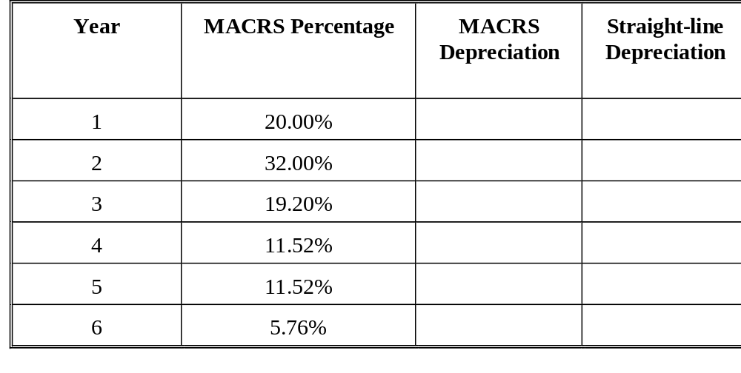
Straight Line vs. MACRS Depreciation
$6000
$9600
$5760
$3456
$3456
$1728
$3000
$6000
$6000
$6000
$6000
$3000

Slide 44
Additions to Net Working Capital
Given NWC at the beginning of the project (date 0), we can calculate future NWC in two ways
  NWC will grow at a rate of X% per period (e.g 3%)
NWC(year 2) = NWC(year1)*1.03
  NWC will equal Y% of sales each period (e.g. 15%)
NWC(year 2) = 0.15*Sales(year 2)
All NWC is recovered at the end of the project.
  Inventories are run down
  Unpaid bills are paid.
  Bring NWC account to zero.

Slide 45
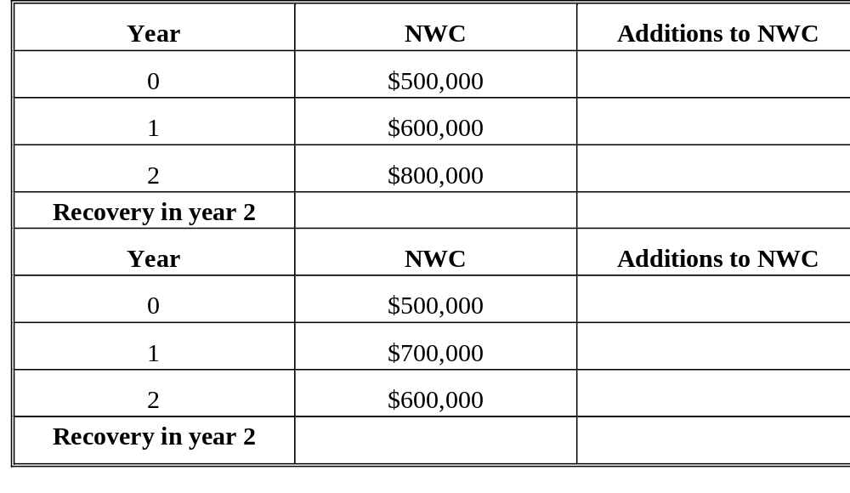
Recovering NWC at the end of the project
-$500,000
-$100,000
-$200,000
+$800,000=$600,000
-$500,000
-$200,000
$100,000
$600,000

Slide 46
Ways to Capital Budgeting Problems
Item by item Discounting
Whole Project Discounting
  Calculate project cash flows from pro forma financials
    Operating Cash Flows
    Net Capital Spending
    Additions to NWC
Notes:
Item by item discounting
Separately forecast revenues, costs and depreciation and discount each item.
Can use different discount rates
Whole project discounting
Determine project cash flows from financial statements
a.Operating Cash Flow
b.Net Capital Spending
i.We will only buy equipment at date 0.
ii.We will only sell equipment at the end of the project. If, at the end of the project, we sell the equipment and the market value is greater than the book value, we record the after-tax cash flow from the sale.
c.Additions to NWC
i.We recover NWC at the end of the project.

Slide 47
Evaluating equipment
with different economic lives
Assumptions
  initial cost versus maintenance
  perpetuity
Equivalent Annual Costs - present value of project’s costs calculated on an annual basis
  annuity
Notes:
Assumptions
deciding between 2 pieces of equipment. One costs more initially, but has lower maintenance costs and will last longer than the other
When the equipment wears out, we replace it, so we are basically buying the equipment in perpetuity
Equivalent annual cost - present value of projects costs calculated on an annual basis
What annuity amount paid over the life of the equipment would have a PV equal to the PV of the equipment’s costs?

Slide 48
Evaluating equipment
with different economic lives
Machine A
Machine B
Costs
Annual Operating Costs
Replace
$100
$140
$10
$8
Every 2 years
Every 3 years
Notes:
Example: A firm is considering which of two stamping machines to buy. Machine A costs $100 to buy and $10 per year to operate. It wears out and must be replaced every two years. Machine B costs $140 to buy and $8 per year to operate. It lasts for 3 years and then must be replaced. Ignoring taxes, which machine should the firm buy if the appropriate discount rate is 10%?
Note that all numbers are costs, so we want the cheapest alternative
What is the present value of the cost of Machine A?
PV(A) = -100 + [-10/1.1] + [-10/1.1²] = -117.36
PV(B) = -140 + [-8/1.1] + [-8/1.1²] + [-8/1.1³]= -159.89
Can’t compare because of different lives

Slide 49
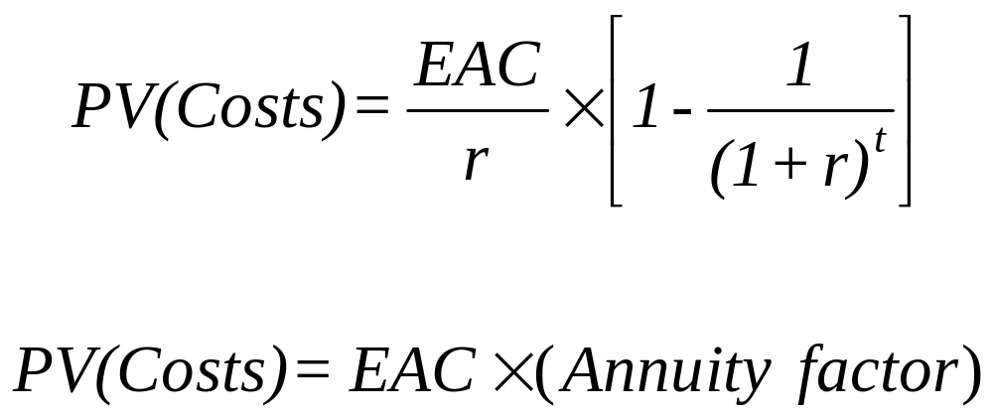
Evaluating equipment with different economic lives
The equivalent annual cost (EAC) is the present value of a project's costs calculated on an annual basis.
Notes:
What annuity amount over 2 (3) years has a present value of -117.36
(-159.89)?
What is the EAC for Machine A? Machine B?
-117.36 = [EAC / r] [1 - 1/(1 + r)^{t} ]
-117.36 = EAC / 0.10 [1 - 1/1.1² ]
EAC(A) = -67.62
EAC(B) = -64.29

